Slide 1
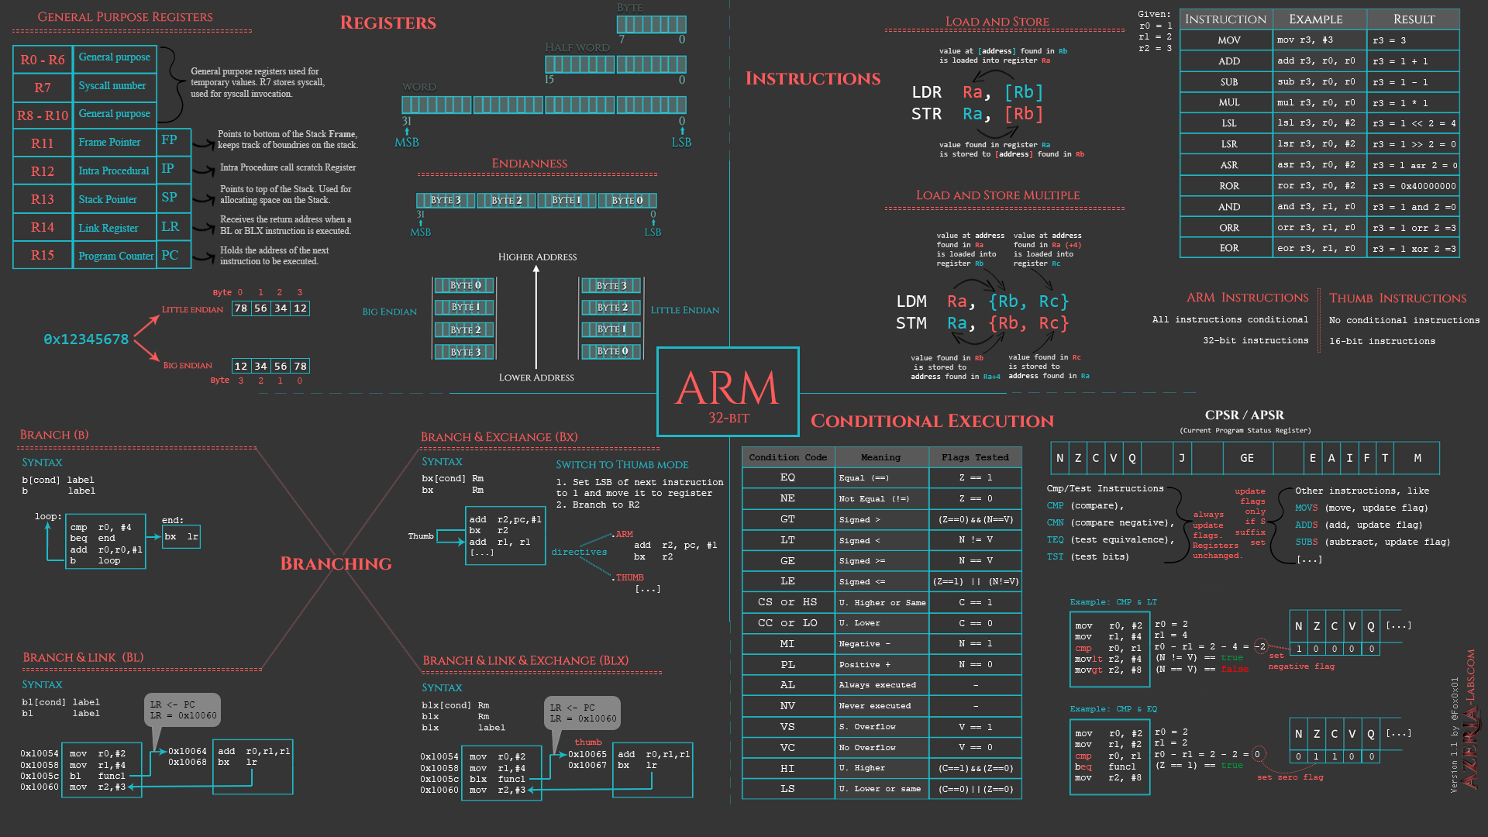
Loop
8086 Assembly
CSE 315 January 2022
Md. Tareq Mahmood
Department of CSE, BUET

Slide 2
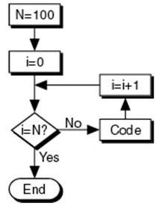
FOR Loop
Write a program to display a row of 80 stars ‘*’
FOR 80 times DO
display ‘*’
END_FOR
MOV CX, 80 ; number of ‘*’ to display
MOV AH, 2 ; char display function
MOV DL, ‘*’ ; char to display
TOP:
INT 21h ; display a star
LOOP TOP ; repeat 80 times
Example 6-8: Assembly Language Programming

Slide 3
Caution!
‘For loop’ implemented using LOOP is executed at least once
If CX contains 0 when loop is entered, the LOOP instruction will decrement CX to FFFFh
The loop will be executed 65535 more times
JCXZ (jump if CX is zero) may be used
JCXZ SKIP
TOP:
; body of the loop
LOOP TOP
SKIP:

Slide 4
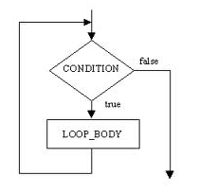
WHILE Loop
WHILE condition DO
statements
END_WHILE
Write a program to count the characters in an input line
Initialize count to 0
Read a character
WHILE character <> carriage_return DO
count = count + 1
read a character
END_WHILE
MOV DX, 0 ; DX counts the characters
MOV AH, 1 ; read char function
INT 21h ; read a char in AL
WHILE_:
CMP AL, 0DH ; CR?
JE END_WHILE
INC DX
INT 21h
JMP WHILE_
END_WHILE:
Example 6-9: Assembly Language Programming

Slide 5
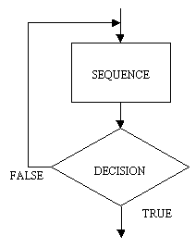
REPEAT Loop
REPEAT
statements
UNTIL condition
Write a program to read characters until a blank/space is read
REPEAT
read a character
UNTIL character is a blank
MOV AH, 1 ; read char function
REPEAT:
INT 21h ; read a char in AL
CMP AL, ‘ ‘ ; a blank?
JNE REPEAT ; no, keep reading
Example 6-10: Assembly Language Programming

Slide 6
Reference
Chapter 6

